Slide 1

HANDS-ON WITH REACT

Slide 2

Think of a volume slider component on a music player app. The volume can be changed over the lifetime of the app.
In React, data that changes over time is called state. State is like a component’s memory.
In the example above, the volume would be stored as a state value so that it could be changed over time.
React
state

Slide 3

State should be considered as variables in react. State is also considered to be the ‘single source of truth’
Props should never be changed, but what we can do instead is deconstruct them into State. This is what is then displayed in the Virtual Dom
To use state, all we need to do is import it at the top of our component and create the states (variables) within our functions
React
state

Slide 4
Creating State is now very easy in our code.
We simply create a new const and create an array made up of the State name (variable name) and a function which defines how to change the state.
Finally, we set the initial value of the State
In the absence of a starting value you should set the type of the state like so:
React
state
State name
Function to change State
Starting Value
Notes:
When using a default value the type will be inferred, otherwise it can be set using <>

Slide 5

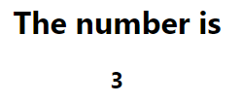

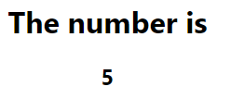
We can then output the value of the State by simply calling the name in the code, just like a JavaScript variable.
Later in the code, I can create a button which calls the setNumber() function to update the state. This edits the DOM to reflect the new value of State
React
state

Slide 6
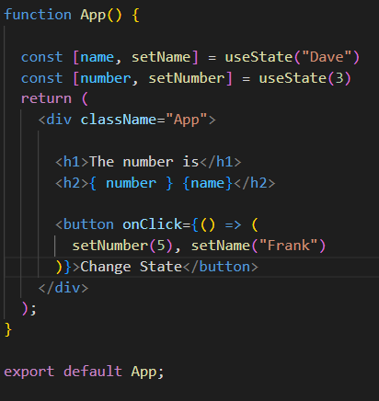
The Process is the same for all State creation and updating
React
state

Slide 7
QuickLab 8
State

